Slide 1
CFD Analysis for Installation of Deep Sea Valve on open well leak
for
DEEP SEA INNOVATIONS LLC
Monee, Illinois
by
TAC Engineering, Inc., Cincinnati, Ohio
and
Kinetic Vision, Cincinnati, Ohio
August 19, 2015

Slide 2
PROBLEM:
Placing a control valve on the open end of a leaking oil pipe which is positioned 10 feet above the ocean floor with a 9 inch inside pipe diameter, leaking oil flow rate of 5,000 gpm, with leak outlets positioned at ocean depths of 1,200 and 10,000 feet.
ASSUMPTIONS:
Ocean has no current
Ocean floor is planar
Turbulence in pipe is 5%
Flow is incompressible
Oil flow is constant
The pipe contains only oil
No gasses are exiting the pipe
The housing is fixed in space in the simulations and the forces exerted on the housing by the flow is captured

Slide 3
SECTION ONE – Slides 5 to 11
Define the flow environment of a leaking pipe flowing at 5,000 gpm at an ocean depth of 10,000 feet and oil temperatures of 5 and 65.6 degrees C (41 and 150 degrees F).
SECTION TWO – Slides 13 to 17
Define the plume difference between 1,200 feet of ocean depth and 10,000 feet, both flowing at 5000 gpm.
SECTION THREE – Slides 19 to 27
Determine loads on the valve assembly positioned on centerline
at the maximum turbulence point eleven feet above the leaking pipe.
Determine loads on valve assembly off center by one pipe diameter.
SECTION FOUR – Slides 29 to 37
Determine loads on the valve assembly positioned on centerline and one foot above the leaking pipe.
Determine loads on the valve assembly at one foot above and off center by one pipe diameter.

Slide 4
SECTION ONE – Slides 5 to 11
Define the flow environment of a leaking pipe flowing at 5,000 gpm at an ocean depth of 10,000 feet and oil temperatures of 5 and 65.6 degrees C (41 and 150 degrees F).
To view an animation, go to the slide show tab and then choose “From Beginning” or “From Current Slide”
The CFD program has to begin the calculation from a static condition and
develop the flow to steady state. Therefore pay particular attention to the
final portions of each animation. This is the steady state condition of interest.
When viewing the animations in slide 5 and 7, note that the very top of the high speed flow (magenta) wags back and forth indicating turbulence.

Slide 5
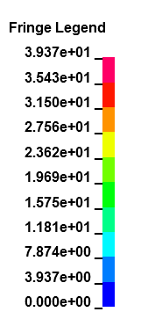
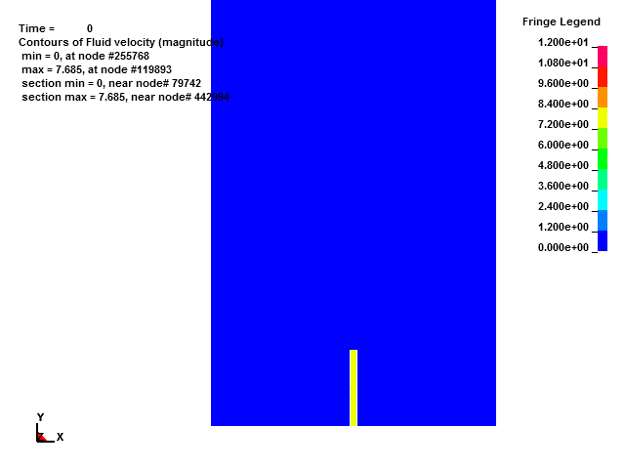
LEAK PLUME – 10,000 ft. – Cold Oil (High Velocity Flow Rate Scale)
Velocity legend illustrates velocity field from 0-39.4 ft/s. Low range velocity flow rate is used in the next slide for better visual definition of leak plume.
Feet/Sec
*Animations play in Slide Show mode only
Slide 5

Slide 6
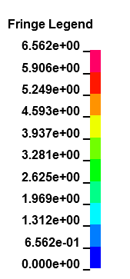
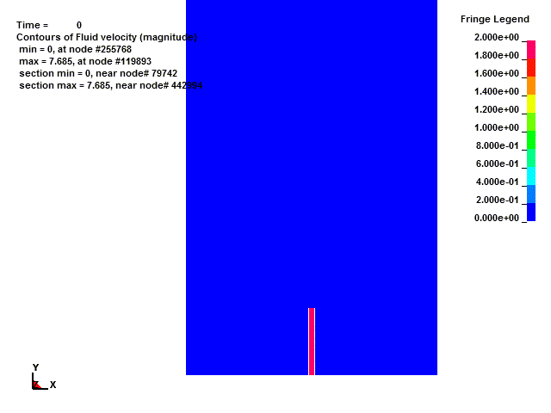
LEAK PLUME – 10,000 ft. – Cold Oil (Low Velocity Flow Rate Scale)
Velocity legend illustrates velocity field from 0-6.6 ft/s (everything above 6.6 ft/s is colored as magenta). *NOTE: These results are the exact same as the previous slide.
Feet/Sec
*Animations play in Slide Show mode only
Slide 6

Slide 7
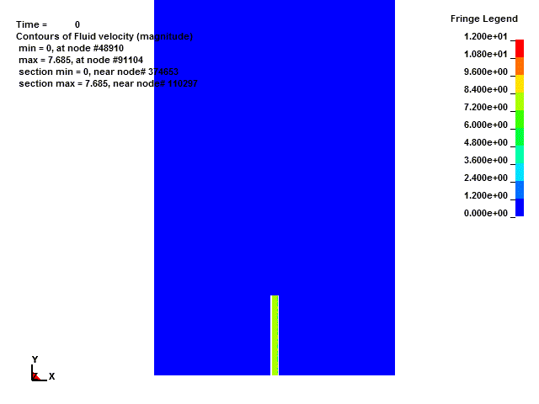
LEAK PLUME – 10,000 ft. – Hot Oil (High Velocity Flow Rate Scale)
Velocity legend illustrates the velocity field from 0-39.4 ft/s. Low range velocity flow rate scale is used in the next slide for better visual definition of leak plume.
Feet/Sec
*Animations play in Slide Show mode only
Slide 7

Slide 8
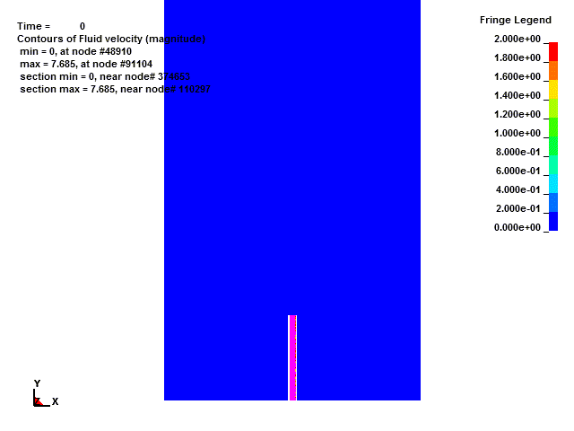
LEAK PLUME – 10,000 ft. – Hot Oil (Low Velocity Flow Rate Scale)
Velocity legend illustrates the velocity field from 0-6.6 ft/s (everything above 6.6 ft/s is colored as magenta). *NOTE: These results are the exact same as the previous slide.
Feet/Sec
*Animations play in Slide Show mode only
Slide 8

Slide 9
Oil/Water Interface – 10,000 ft. – Cold Oil
Note that the column of oil twists as it exits the pipe
Go to slide show and choose “From Current Slide”
*Animations play in Slide Show mode only
Slide 9

Slide 10
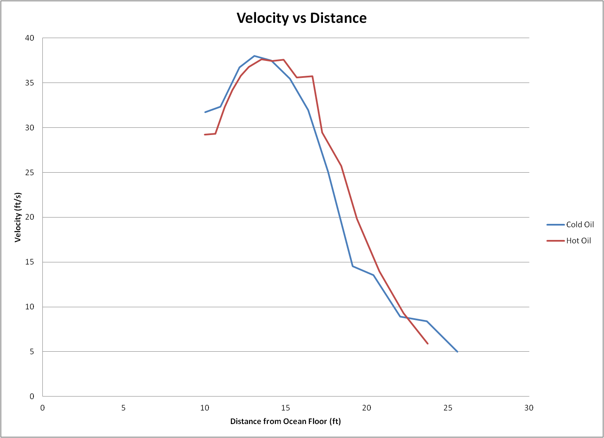
Cold & Hot Oil Velocity vs. Distance From Leak Outlet at 10,000 ft.
There is minimal difference between the velocities of the cold and hot oil
Slide 10

Slide 11
CONCLUSIONS
The point of maximum turbulence appears to be approximately eleven feet from the open end of the pipe.
There is minimal difference between the velocities of cold and hot oil.
Slide 11

Slide 12
SECTION TWO – Slides 13 to 17
Define the plume difference between 1,200 feet of ocean depth and 10,000 feet, both flowing at 5000 gpm.

Slide 13
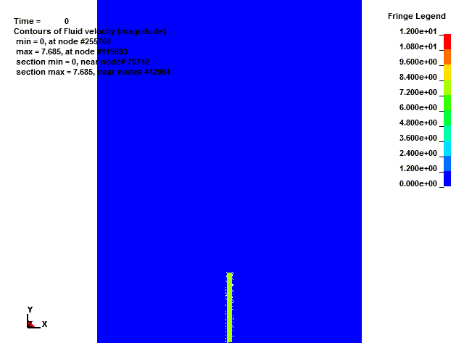
LEAK PLUME – 1,200 ft. – Cold Oil (High Velocity Flow Rate Scale)
Velocity legend illustrates velocity field from 0-39.4 ft/s. Low range velocity flow rate scale is used in the next slide for better visual definition of leak plume.
Feet/Sec
*Animations play in Slide Show mode only
Slide 13

Slide 14
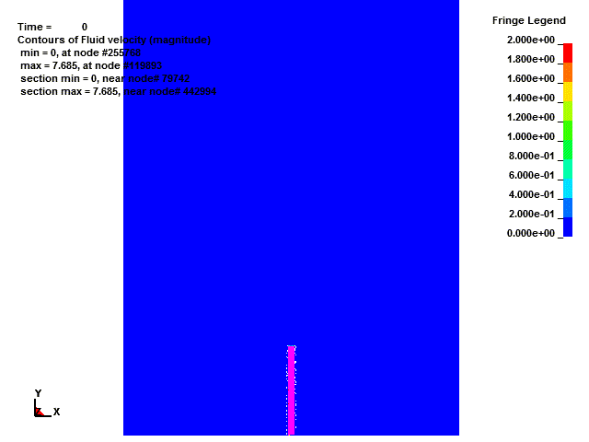
LEAK PLUME – 1,200 ft. – Cold Oil (Low Velocity Flow Rate Scale)
Velocity legend illustrates velocity field from 0-6.6 ft/s (everything above 6.6 ft/s is colored as magenta). *NOTE: These results are the exact same as the previous slide.
Feet/Sec
*Animations play in Slide Show mode only
Slide 14

Slide 15
Oil/Water Interface – 1,200 ft. – Cold Oil
Go to slide show and choose “From Current Slide”
*Animations play in Slide Show mode only
Slide 15

Slide 16
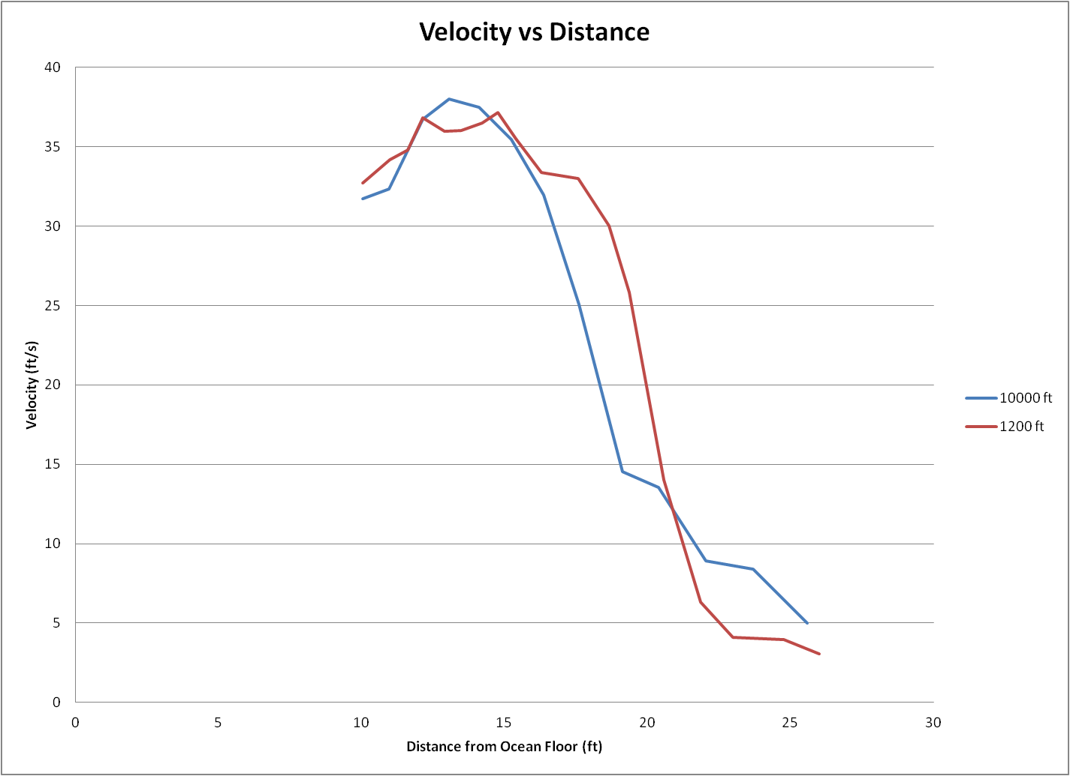
Velocity Comparison at 1,200 & 10,000 ft. vs. Distance From Leak Outlet
Slide 16

Slide 17
CONCLUSION
There is minimal difference between the velocities at ocean depths of 1,200 & 10,000 feet
Flow rate determines plume size and velocity, not ocean depth.

Slide 18
SECTION THREE – Slides 19 to 27
Determine loads on the valve assembly positioned on centerline
at the maximum turbulence point eleven feet above the leaking pipe.
Determine loads on valve assembly off center by one pipe diameter.

Slide 19
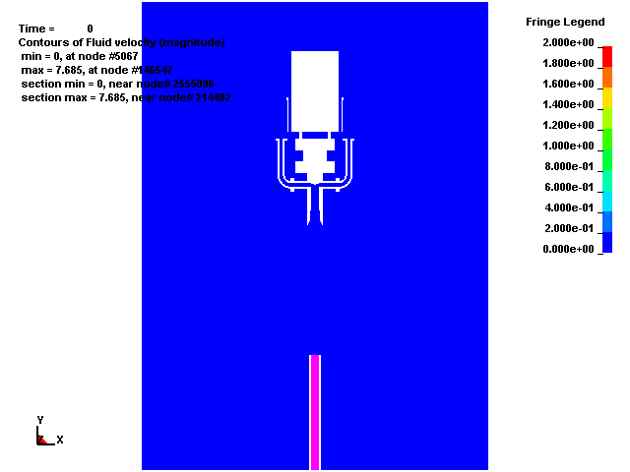
LEAK PLUME – 10,000 ft. (Low Velocity Flow Rate Scale) Housing Centered 11 ft. Above Leak Outlet
Feet/Sec
*Animations play in Slide Show mode only
Slide 19

Slide 20
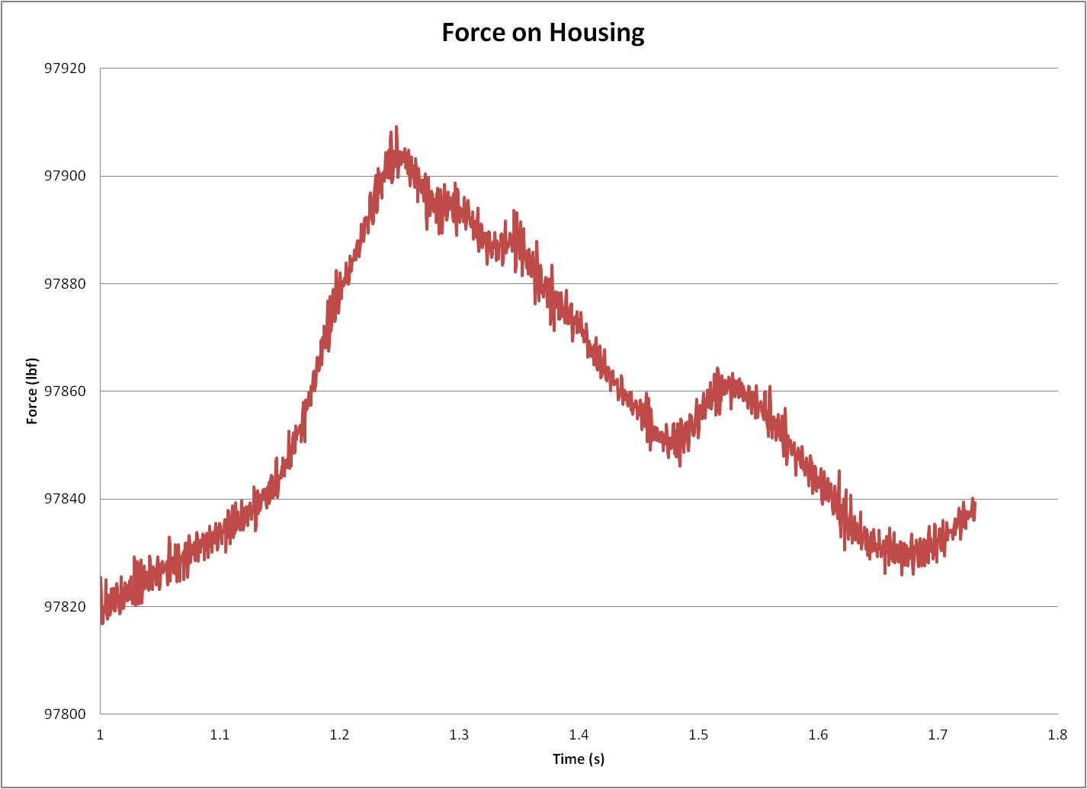
Vertical Force Results – 10,000 ft. Housing Centered 11 ft. Above Leak Outlet
Peak Vertical Force = 97909 lbf
Min Vertical Force = 97817 lbf
Slide 20

Slide 21
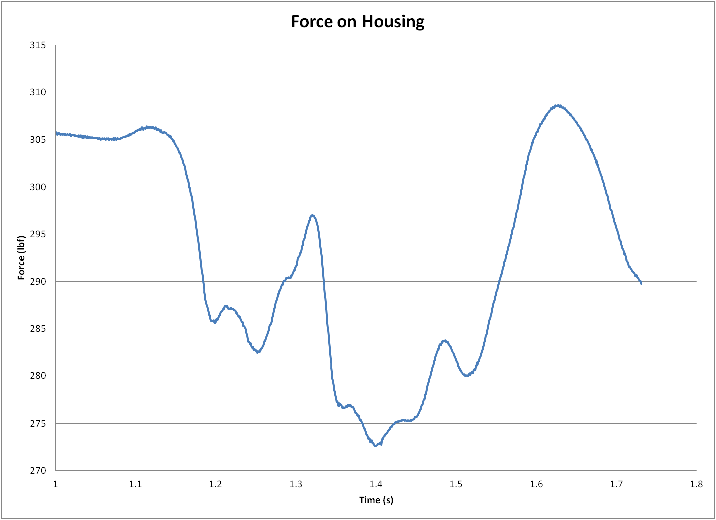
Lateral Force Results – 10,000 ft. Housing Centered 11 ft. Above Leak Outlet
Peak Lateral Force = 308 lbf
Min Lateral Force = 273 lbf
Slide 21

Slide 22
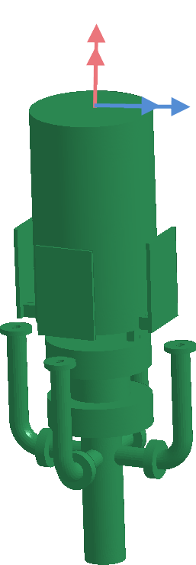
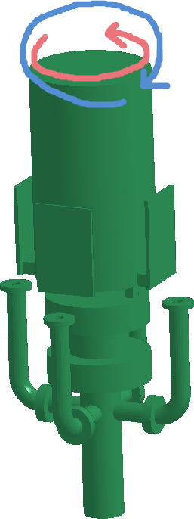
Twisting Moment Results – 10,000 ft. Housing Centered 11 ft. Above Leak Outlet
Peak Twisting Moment = 147 lbf-ft
Peak Bending Moment = 2820 lbf-ft
*NOTE: Twisting moment is about the cable axis, bending moment is pivoting the housing about the attachment point
Slide 22

Slide 23
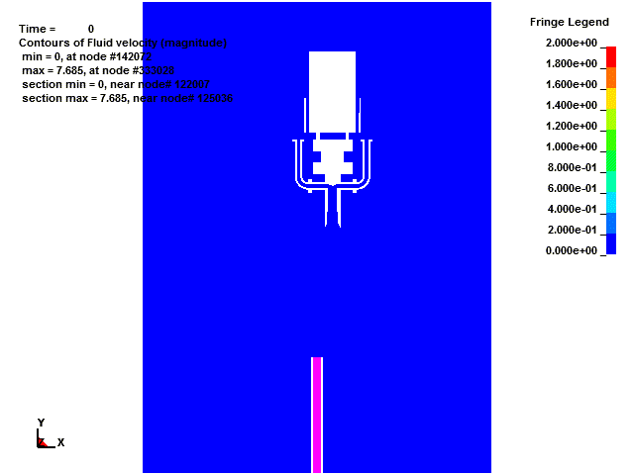
LEAK PLUME – 10,000 ft. (Low Velocity Flow Rate Scale) Housing 11 ft. Above Leak Outlet and Displaced Laterally One Pipe Diameter
Feet/Sec
*Animations play in Slide Show mode only
Slide 23

Slide 24
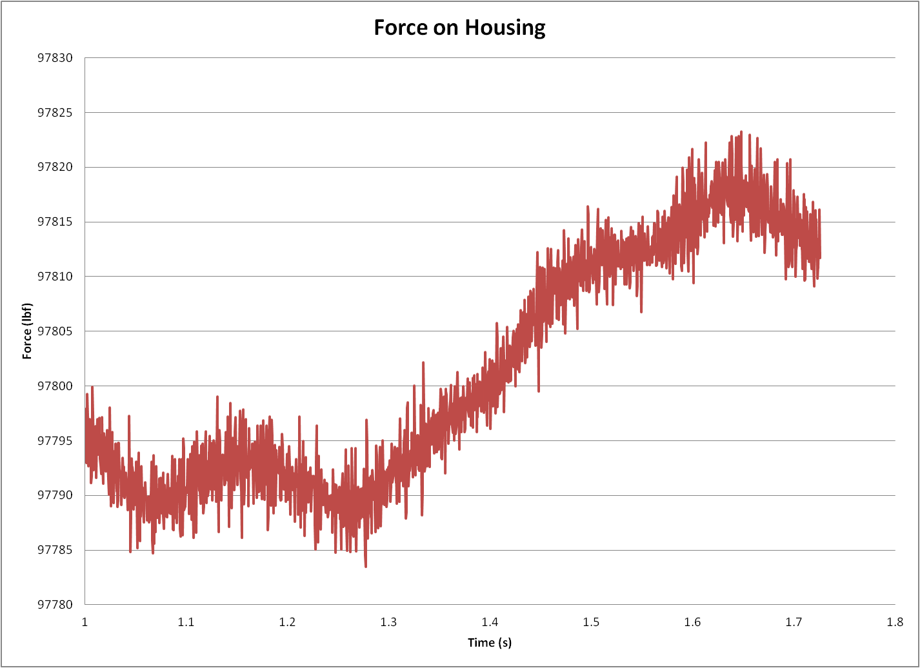
Vertical Force Results – 10,000 ft. Housing 11 ft. Above Leak Outlet and Displaced Laterally One Pipe Diameter
Peak Vertical Force = 97823 lbf
Min Vertical Force = 97783 lbf
Slide 24

Slide 25
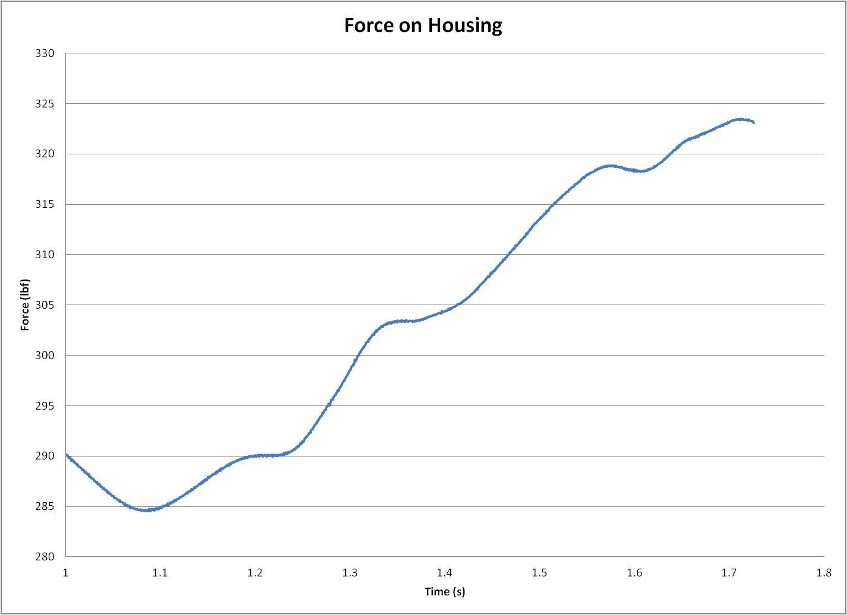
Lateral Force Results – 10,000 ft. Housing 11 ft. Above Leak Outlet and Displaced Laterally One Pipe Diameter
Peak Lateral Force = 323 lbf
Min Lateral Force = 285 lbf
Slide 25

Slide 26
Twisting Moment Results– 10,000 ft. Housing 11 ft. Above Leak Outlet and Displaced Laterally One Pipe Diameter
Peak Twisting Moment = 147 lbf-ft
Peak Bending Moment = 3170 lbf-ft
*NOTE: Twisting moment is about the cable axis, bending moment is pivoting the housing about the attachment point
Slide 26

Slide 27
TABLUATED RESULTS
 | Max Vertical Force (lbf) | Max Lateral Force (lbf) | Max Twisting Moment (ft-lbf) | Max Bending Moment (ft-lbf)
11' Centered | 97909 | 308 | 147 | 2820
11' Shift | 97823 | 323 | 147 | 3170
Slide 27

Slide 28
SECTION FOUR – Slides 29 to 37
Determine loads on the valve assembly positioned on centerline and one foot above the leaking pipe.
Determine loads on the valve assembly at one foot above and off center by one pipe diameter.
Slide 28

Slide 29
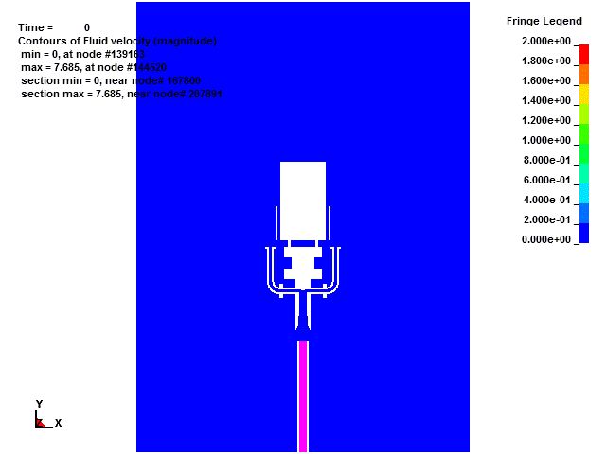
LEAK PLUME – 10,000 ft. (Low Velocity Flow Rate Scale) Housing Centered One ft. Above Leak Outlet
Feet/Sec
*Animations play in Slide Show mode only
Slide 29

Slide 30
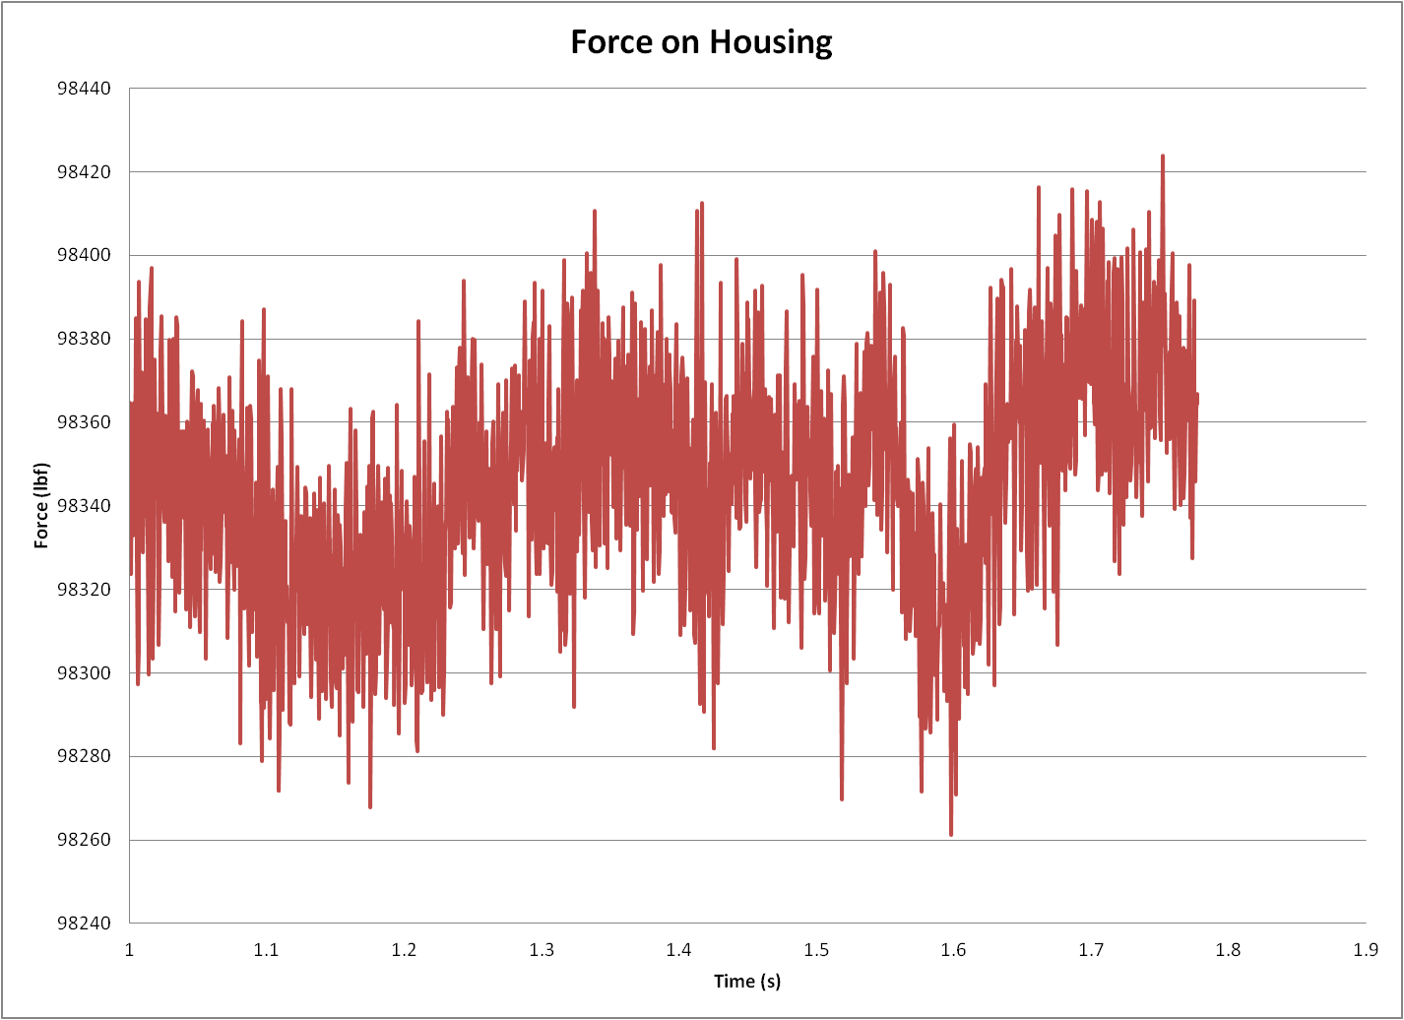
Vertical Force Results – 10,000 ft. Housing Centered One ft. Above Leak Outlet
Peak Vertical Force = 98424 lbf
Min Vertical Force = 98261 lbf
Slide 30

Slide 31
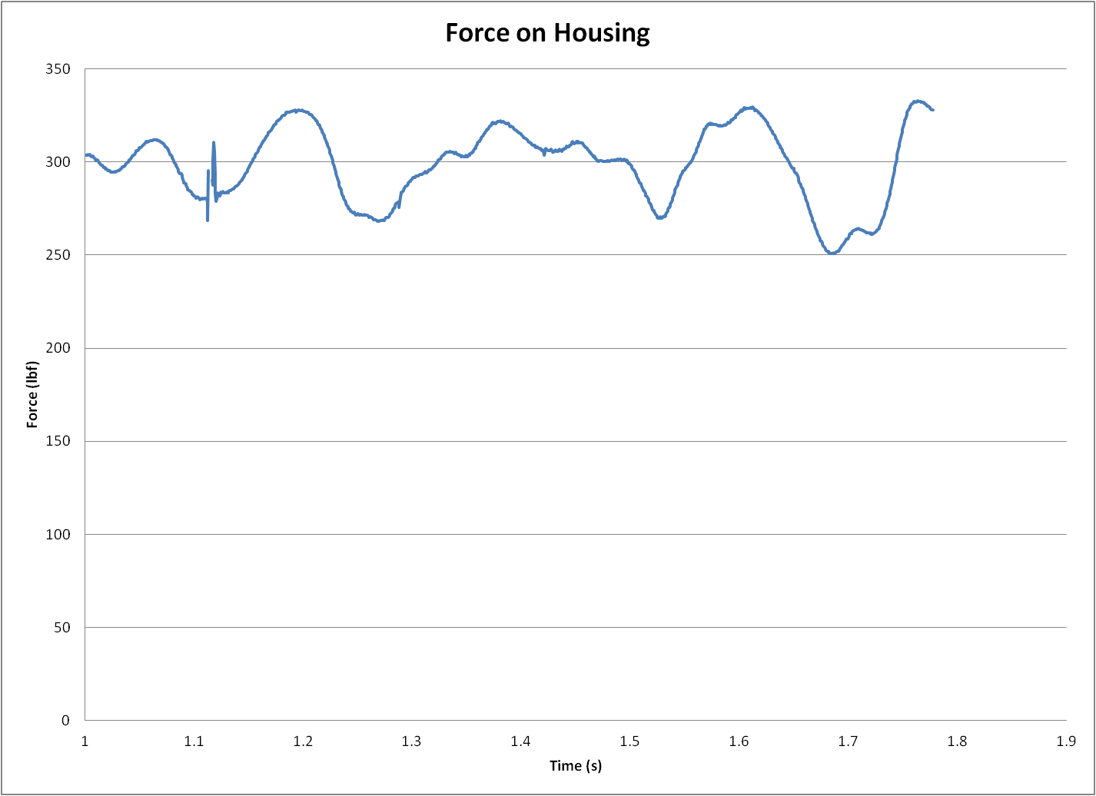
Lateral Force Results – 10,000 ft. Housing Centered One ft. Above Leak Outlet
Peak Lateral Force = 333 lbf
Min Lateral Force = 250 lbf
Slide 31

Slide 32
Moment Results – 10,000 ft. Housing Centered One ft. Above Leak Outlet
Peak Twisting Moment = 154 lbf-ft
Peak Bending Moment = 3360 lbf-ft
*NOTE: Twisting moment is about the cable axis, bending moment is pivoting the housing about the attachment point
Slide 32

Slide 33
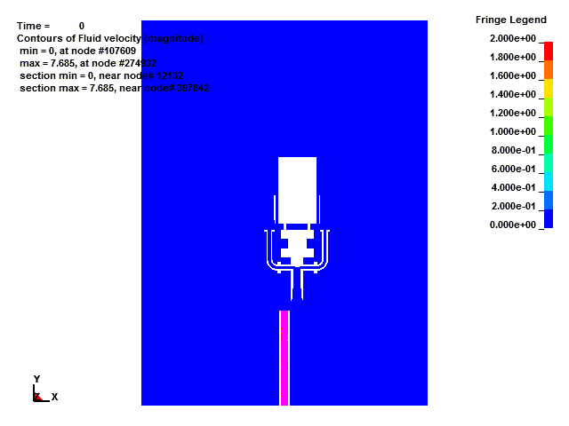
LEAK PLUME – 10,000 ft. (Low Velocity Flow Rate Scale) Housing One ft. Above Leak Outlet and Displaced Laterally One Pipe Diameter
Feet/Sec
*Animations play in Slide Show mode only
Slide 33

Slide 34
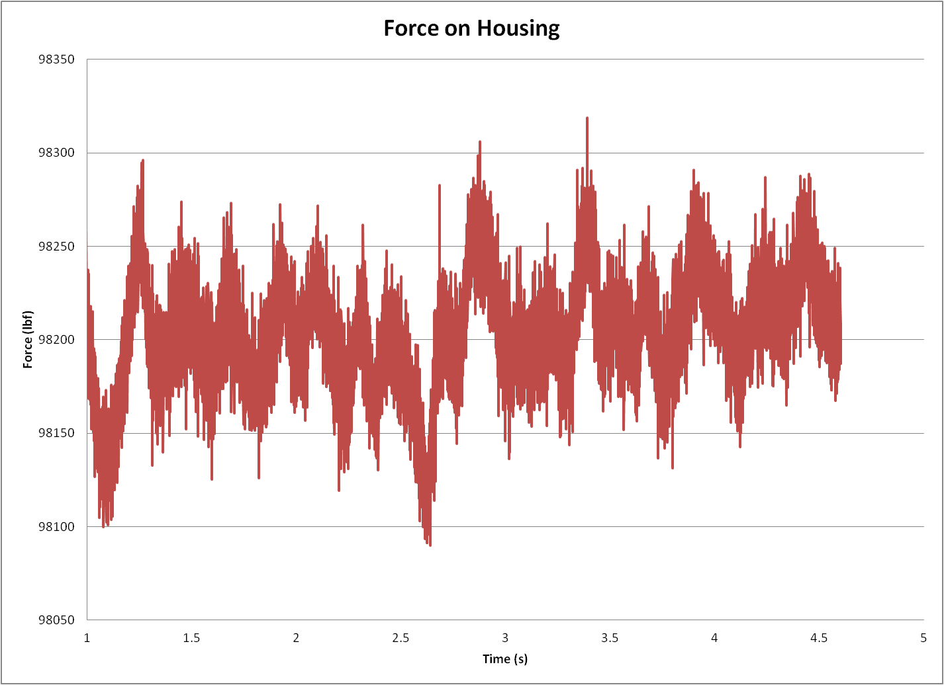
Results – 10,000 ft. Housing One ft. Above Leak Outlet and Displaced Laterally One Pipe Diameter
Peak Vertical Force = 98345 lbf
Min Vertical Force = 98089 lbf
Slide 34

Slide 35
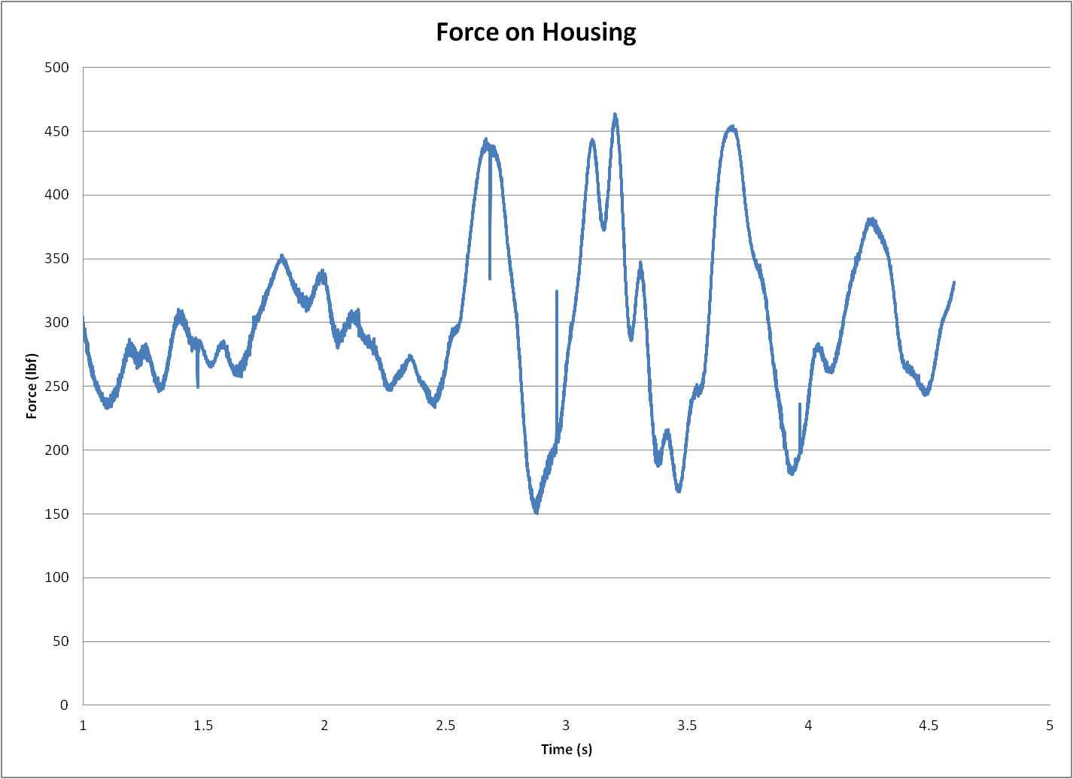
Resultant Lateral Forces – 10,000 ft. Housing One Ft. Above Leak Outlet and Displaced Laterally One Pipe Diameter
Peak Lateral Force = 464 lbf
Min Lateral Force = 150 lbf
Slide 35

Slide 36
Twisting Moment Results – 10,000 ft. Housing One Ft. Above Leak Outlet and Displaced Laterally One Pipe Diameter
Peak Twisting Moment = 381 lbf-ft
Peak Bending Moment = 4840 lbf-ft
*NOTE: Twisting moment is about the cable axis, bending moment is pivoting the housing about the attachment point
Slide 36

Slide 37
TABULATED RESULTS
 | Max Vertical Force (lbf) | Max Lateral Force (lbf) | Max Twisting Moment (ft-lbf) | Max Bending Moment (ft-lbf)
1' Centered | 98424 | 333 | 154 | 3360
1’ Shift | 98345 | 464 | 381 | 4840
Slide 37

Slide 38
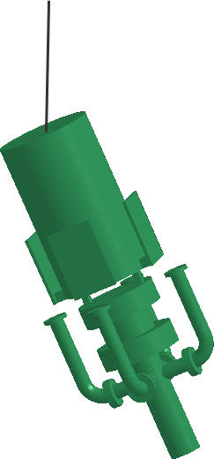
CONCLUSIONS - SECTION 3 & 4
The peak vertical forces are all similar as shown in the chart below.
The lateral force on the housing is constantly changing direction due to the turbulence of the oil. See the flow image on the following page.
The modest magnitude of the lateral forces indicate that the valve can be guided to a position to close the defined leak. For example;
if it can be assumed that this force is constant and acting in a single direction,
If it can be assumed there is no drag,
If the current housing weighs 50 tons, then
it is estimated that the maximum lateral force (1 ft. Shifted) might move the valve assembly 9 inches in 10 seconds, possibly longer.
the resultant bending moment might also pivot the housing about its suspension point by 0.7°, thereby displacing the inlet of the valve 2.1 inches off its centerline.
With the assembly 1 ft. shifted off center and tilted 0.7° there is no oil flowing through the housing. Deflector plates would not provide steering at this location. Would likely have to pull housing back up and start descent again if no other steering is provided.
This analysis suggests there is ample time to apply corrective alignment forces.
 | Max Vertical Force (lbf) | Max Lateral Force (lbf) | Max Twisting Moment (ft-lbf) | Max Bending Moment (ft-lbf)
11' Centered | 97909 | 308 | 147 | 2820
1' Centered | 98424 | 333 | 154 | 3360
11' Shift | 97823 | 323 | 147 | 3170
1’ Shift | 98345 | 464 | 381 | 4840
Slide 38

Slide 39
CONCLUSIONS - SECTION 3 & 4
Note the twisting motion in the oil stream.
Oil bubbles float to surface
Loss of velocity
Oil stream
Pipe exit
Slide 39

Slide 40
APPENDICIES

Slide 41
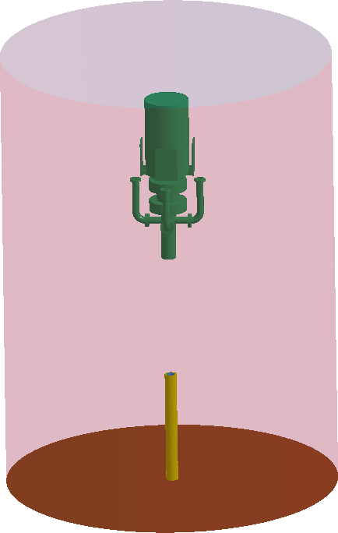
Geometry
The pipe geometry was set to extend 10 feet above the ocean floor with a 9 inch ID
The ocean surrounding the pipe was modeled as a cylinder with a diameter of 37.5’ and a height of 40.5’
Slide 41

Slide 42
Simulation Setup – 10,000 ft.
Materials
Ocean is filled with water
Density 0.036 lb/in³
Viscosity 2.730e-5 lbf s/ft²
Pipe is filled with oil
Density 0.0307 lb/in³
Viscosity 0.00342 lbf s/ft² Cold
Boundary Conditions – 10,000 ft deep
Base of pipe is inlet of oil at 25.2 ft/s average velocity with 5% turbulence
5000 gpm flowrate
Walls of pipe and ocean floor are a no-slip wall
Walls of housing are a no-slip wall
Side of water column is inlet/outlet with a pressure of 4336 psi
Top of water column is inlet/outlet with a pressure of 4336 psi
Loads
Gravity is applied to the simulation
Slide 42

Slide 43
Simulation Setup – 1,200 ft.
Materials
Ocean is filled with water
Density 0.036 lb/in³
Viscosity 2.730e-5 lbf s/ft²
Pipe is filled with oil
Density 0.0307 lb/in³
Viscosity 0.00342 lbf s/ft² Cold
Boundary Conditions – 1,200 ft deep
Base of pipe is inlet of oil at 25.2 ft/s average velocity with 5% turbulence
5000 gpm flowrate
Walls of pipe and ocean floor are a no-slip wall
Walls of housing are a no-slip wall
Side of water column is inlet/outlet with a pressure of 520 psi
Top of water column is inlet/outlet with a pressure of 520 psi
Loads
Gravity is applied to the simulation
Slide 43

